Slide 1
Basic employee training on Covid-19 infection prevention
June, 2020

Slide 2

What is the coronavirus (Covid-19) virus?
It is a virus related to other coronaviruses that cause the common cold, but can cause much more serious health effects.
It is highly contagious, spreading from person to person.
In just a few months, it has infected millions of people worldwide.

Slide 3

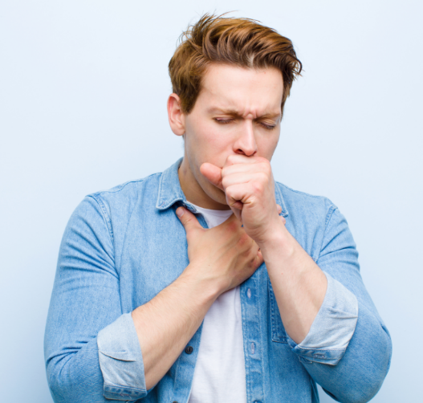
What are the symptoms of infection?
COVID-19 typically causes mild respiratory illness, but can cause severe disease, including pneumonia-like illness.
Typical symptoms include fever, cough, and shortness of breath.
Other symptoms are chills, muscle aches, sore throat, loss of sense of taste or smell.
Symptoms begin 2-14 days after exposure.
Some people have no symptoms.

Slide 4

How is Covid-19 spread?
It is spread from person to person mainly through respiratory droplets from someone who is infected.
It can spread to others from coughing, sneezing, singing and even talking.
It also can spread from contact with contaminated surfaces or objects.
Infected people without symptoms can spread the virus.

Slide 5

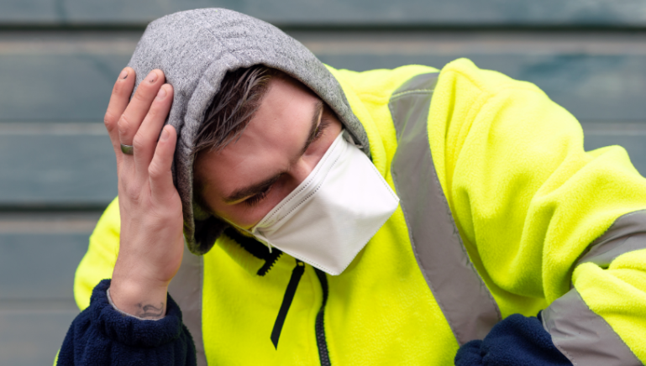
What to do if you feel sick
If you believe you may have the coronavirus, stay home and call your healthcare provider.
If you have been infected, you likely had no symptoms for several days, and you may have passed the infection onto coworkers.
Inform your employer, so they can determine who you may have been in contact with at work.

Slide 6

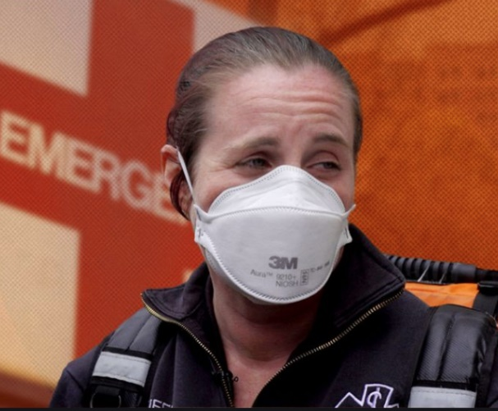
Who is at risk at work?
Extremely High Risk:
Healthcare workers treating or caring for coronavirus infected patients.
EMT/ambulance employees transporting infected persons.
High Risk:
Mortuary workers performing or assisting with autopsies of infected persons.
Courtesy of ABC Radio National - Australia

Slide 7
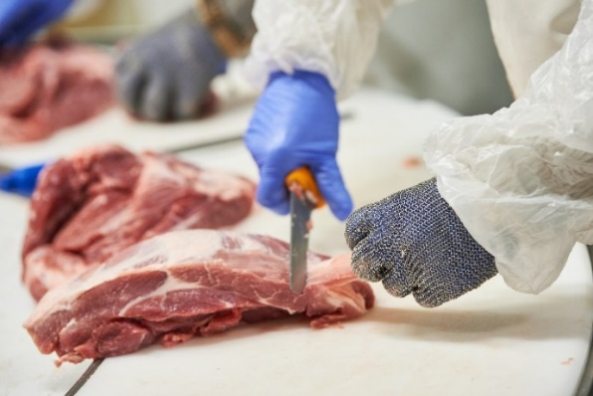
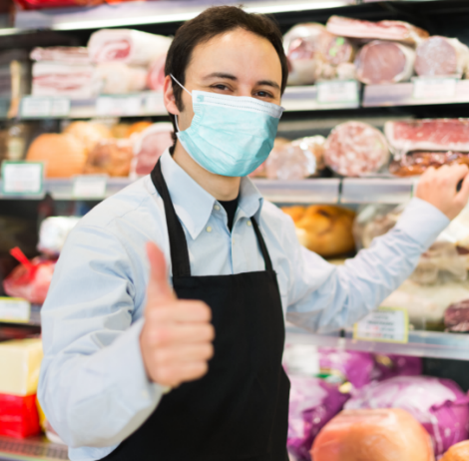
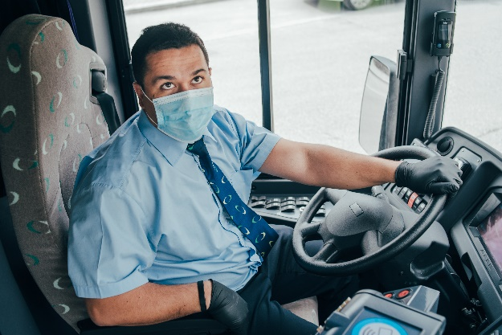
Who is at risk (continued)
Medium Risk:
Any job requiring you to work either:
several times a day within 6 feet of others for several minutes at a time without physical barriers or other prevention measures in place; OR
in a room with 3-6 coworkers providing personal services to healthy clients wearing a face covering.
Examples: grocery store stockers, public transit drivers, kitchen workers, hair salons

Slide 8

Who is at risk (continued)
Low Risk:
Jobs where you can mostly stay at least 6 feet away from coworkers; only needing to briefly pass by up to several times a day.
Negligible (very low) Risk:
When you work alone or around, but separate from several other people; and may only need to pass by once or twice a day.

Slide 9
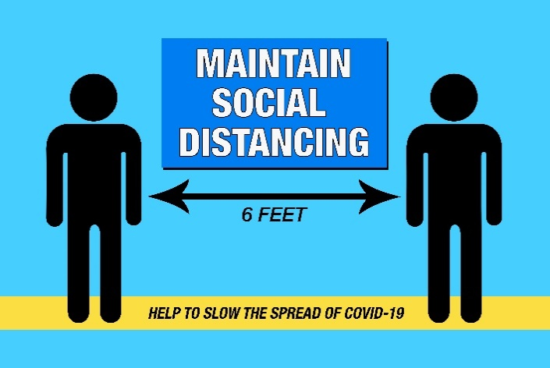

How to protect yourself and others
  Keep physical distance of at least 6 feet.
  Practice frequent hand washing for 20 seconds and/or use hand sanitizer if soap and water are not available.
  Frequently sanitize work surfaces and tools.
  Cover coughs and sneezes and wear a face mask.
  Avoid touching the eyes, nose, or mouth with unwashed hands.
  Stay home if you are sick and avoid co-workers who appear sick.

Slide 10
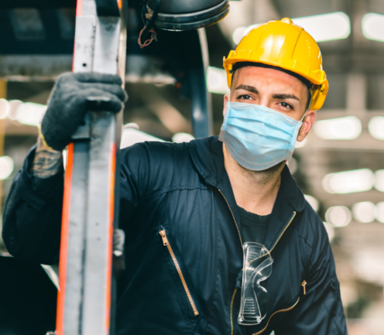
Face Coverings, Masks, and Respirators
All three help prevent risk for spreading the virus to others.
The Center for Disease Control (CDC) estimates that 40% of infections come from people with no symptoms.
Depending on your job, level of risk, and whether prevention measures like physical barriers are used, you may be required to wear a face covering, mask, or respirator.

Slide 11
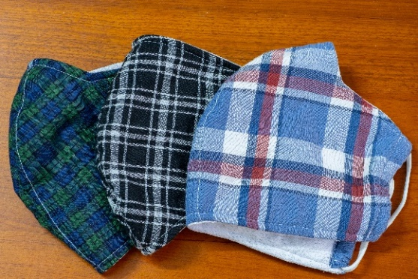
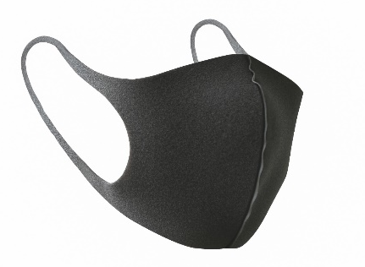
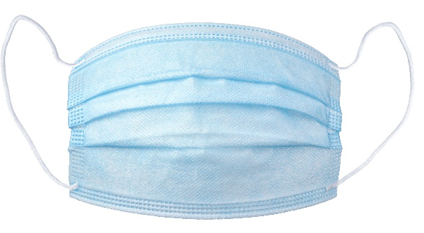
Face coverings, masks, and respirators–what’s the difference?
Homemade cloth face coverings for low risk jobs. Keeps saliva particles from escaping into the air.
Purchased face coverings
(many types) for low-risk jobs. Keeps saliva particles from escaping into the air.
Non-approved, disposable surgical-style mask for medium-risk jobs. Keeps saliva particles from escaping into the air.
N-95 respirator for high- and extremely high-risk jobs. Protects the wearer from inhaling saliva particles already in the air.

Slide 12
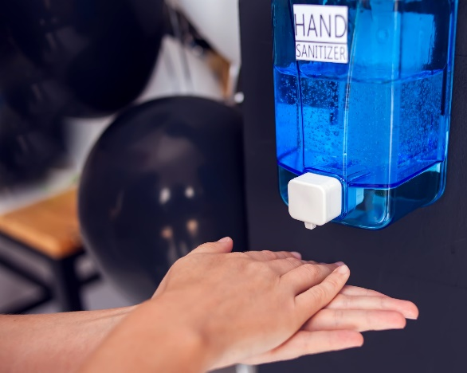
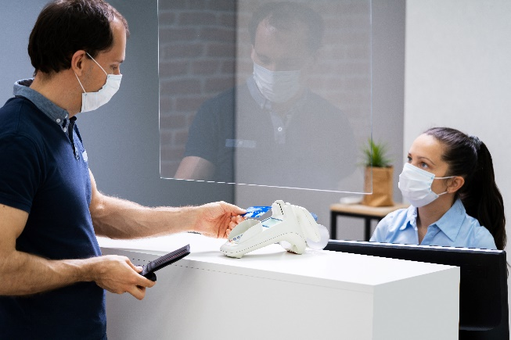
What your employer must do to protect you
Provide hand-washing and sanitizing supplies.
Set up physical distancing and control customer flow.
Install barriers between workers where feasible.
Send home any worker who appears infected.
Provide personal protective equipment (PPE) as needed for the activity being done.
Train you on specific protective measures required at your workplace.

Slide 13
Specific Covid-19 protective measures at your worksite
Your employer is required to have specific procedures for protection against COVID-19 infection. You must be trained on those procedures.
Your employer can add additional slides to cover those specific procedures, or use other training methods.

Slide 14

Worker rights
You have the right to:
  Raise a safety or health concern with your employer or L & I - DOSH, request personal protective equipment, or report a work-related hazard, including COVID-19.
  Receive information and training on job hazards in your workplace.
  Submitting a safety hazard concern to L & I -DOSH
Or call 1-800-423-7233

Slide 15
Specific guidelines for various workplaces
Coronavirus Prevention – summary of general workplace requirements
Coronavirus Prevention in Agriculture & Related Industries
Food Processing-Warehouse Coronavirus Fact sheet
Coronavirus (Covid-19) Protecting Grocery Store Workers
Covid-19 Transmission Risks and facemasks or respirators choices

Slide 16
Safety & Health Consultation Services
Your employer can request help from L & I -DOSH
Safety or Industrial Hygiene consultants provide assistance with building your employer’s safety program, training, identifying and controlling hazards, and following applicable safety rules. No fines or penalties will result from issues uncovered and corrected during a consultation. However, consultants will ask your employer to correct any serious issues and offer assistance.
Request an onsite consultation
1-800-547-8367 or email DOSHConsultation@Lni.wa.gov

